Slide 1
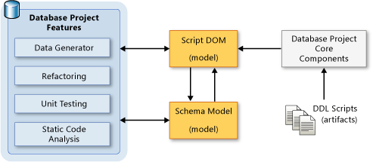
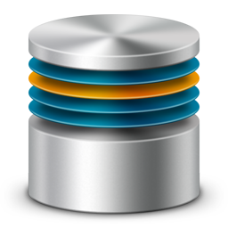


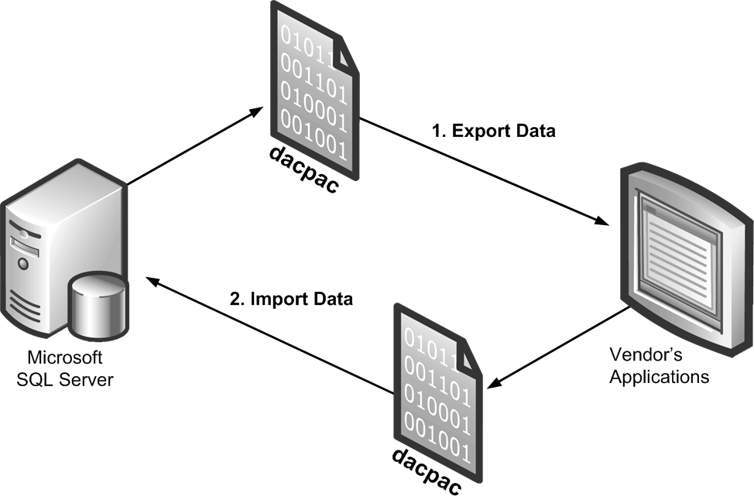
Database Projects in Visual Studio
Data-tier Application, Import, Refactoring, Publish, Schema Comparison, Database Unit Testing
Borislav Statev
Junior DB Developer
Telerik Corp.
Telerik Software Academy
academy.telerik.com

Slide 2


Table of Contents
Data-tier Application
Why use a Database Project
Create Project and Import a DB
Database Refactoring
Schema Compare
Deploy to Database, Publish Profiles and Custom Scripts
Database Unit Testing
Database References

Slide 3
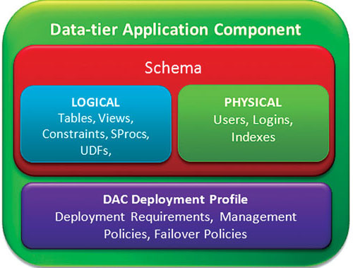
Data-tier Application

Slide 4
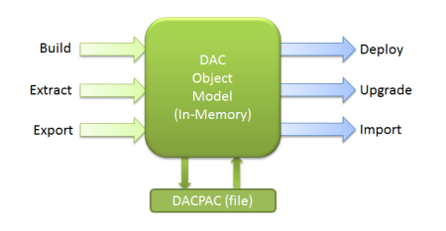
Data-tier Application
Data-tier application (DAC) is:
Entity containing all of the MSSQL database and instance objects, such as tables, views, etc
DAC provides:
Single unit for developing, deploying, and managing the data-tier objects
DAC can be deployed to:
SQL Server or SQL Azure.

Slide 5
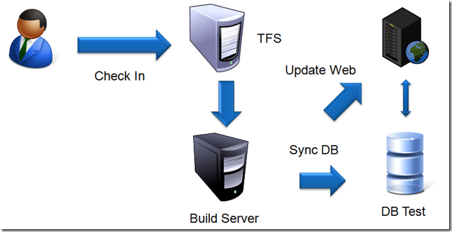
Why Use a Database Project?
Database project helps to:
Apply version control and project management techniques to your database development

Slide 6
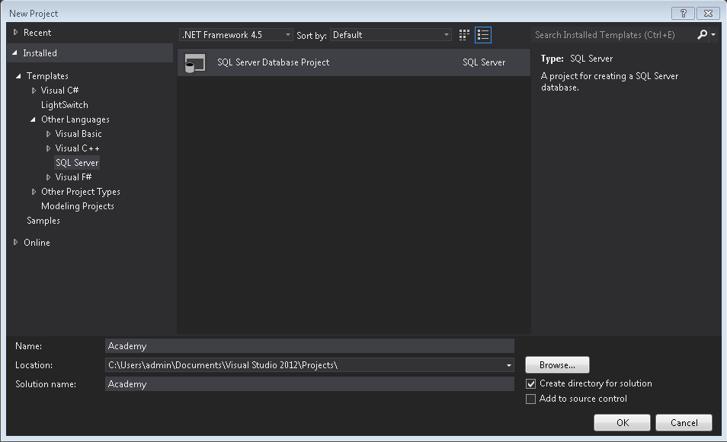
Create Database Project

Slide 7
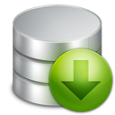
Import a Database
If you already have a database to start with
Can import from the current database schema to a Database project
Import a Database is possible option only if the Database project is empty
Can set a folder structure of the project

Slide 8
Database Refactoring
Rename a database object
Move a database object to a different schema
Database schema:
Logically group objects such as tables, views, stored procedures etc.
Information about
refactoring is recorded
In a refactoring log file

Slide 9
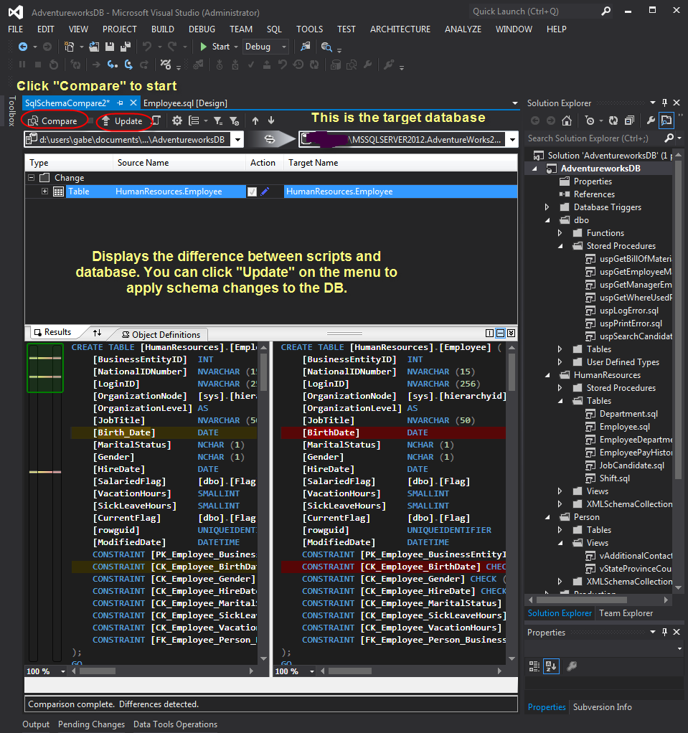
Schema Compare

Slide 10

Schema Compare
Compare:
Project
Database
Data-tier Application
Shows all differences
Can update only selected differences
If compare to database:
Can create a script without uploading

Slide 11
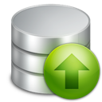
Deploy to Database
Generate script without Publish
When select Publish
Can show errors in the execution of the script
Update all optional differences from the project to the database
Optional criteria can be set in Advanced Publish Settings
Can save Target connection string and Publish settings in a Publish profile

Slide 12
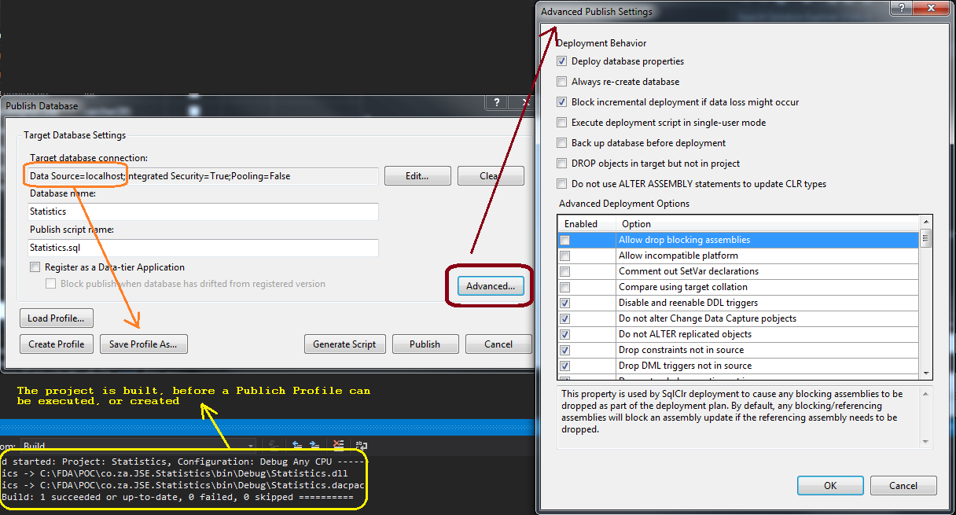
Publish Profiles

Slide 13

Attached Custom Scripts
Two type of custom scripts that can by attached when publishing the database project
Pre-deployment – Attached to the beginning of the publish script
Post-deployment - Attached to the end of the publish script

Slide 14


Database Unit Tests
Reduce the possibility of errors in the functionality of the database
Can be use to stored procedures, functions and views
Contents 3 stages:
Insert data
Check values
Clean data

Slide 15

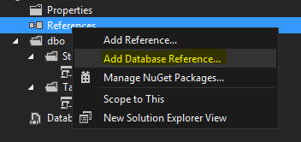
Database References
When have multiple databases that have some level of dependency
One database use objects of other database
Without database reference the database project will not compile
Set database variable
Publish to database using different database instances

Slide 16

Database Project
Live Demo

Slide 17



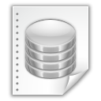
Database Projects in VS
http://academy.telerik.com

Slide 18
Exercises (1)
Create database and database project for Credit company. First table have to stored Users with their UserId, First name, Last name, Age, PIN and Address. Other table have to be for Credits with CreditId, Given amount, Refundable amount, Start date, Expiration date and UserId. Table Payments have to stored PaymentId, PaymentDate, Amount, UserId and CreditId.
Rename column Given amount with Grand amount in table Credits.

Slide 19
Exercises (2)
Create stored procedure UserCreditAmounts that for given UserId returns First name, Last name, Repaid money (sum of all payment amounts for credit), Refundable amount and CreditId.
Create unit test that validate returned values for UserCreditAmounts stored procedure

Slide 20




Free Trainings @ Telerik Academy
C# Programming @ Telerik Academy
csharpfundamentals.telerik.com
Telerik Software Academy
academy.telerik.com
Telerik Academy @ Facebook
facebook.com/TelerikAcademy
Telerik Software Academy Forums
forums.academy.telerik.com

